Slide 1
From "What to Look for in the Night Sky
Go to "Creations in the Night Sky.
Constellations.
Constellations -.
It is no longer to be sought in the starry sky.
It is now to be created in the starry sky.

Slide 2
STAR-.
LINER
Connect the stars to create constellations.
Connect Stars in the Sky.

Slide 3
Selected Missions
Selected Mission

Slide 4






Exosky!

Slide 5
Page Overview
Page Summary

Slide 6



From NASA's data on extrasolar objects
Visualization of the celestial sphere as seen from certain extrasolar objects
Users connect the stars seen in the celestial sphere,
Create your own constellations with your own hands
You can interact on the Internet with the constellations you create.
Interactive exchange platforms are also available.

Slide 7
Future Outlook
Vision For Future

Slide 8
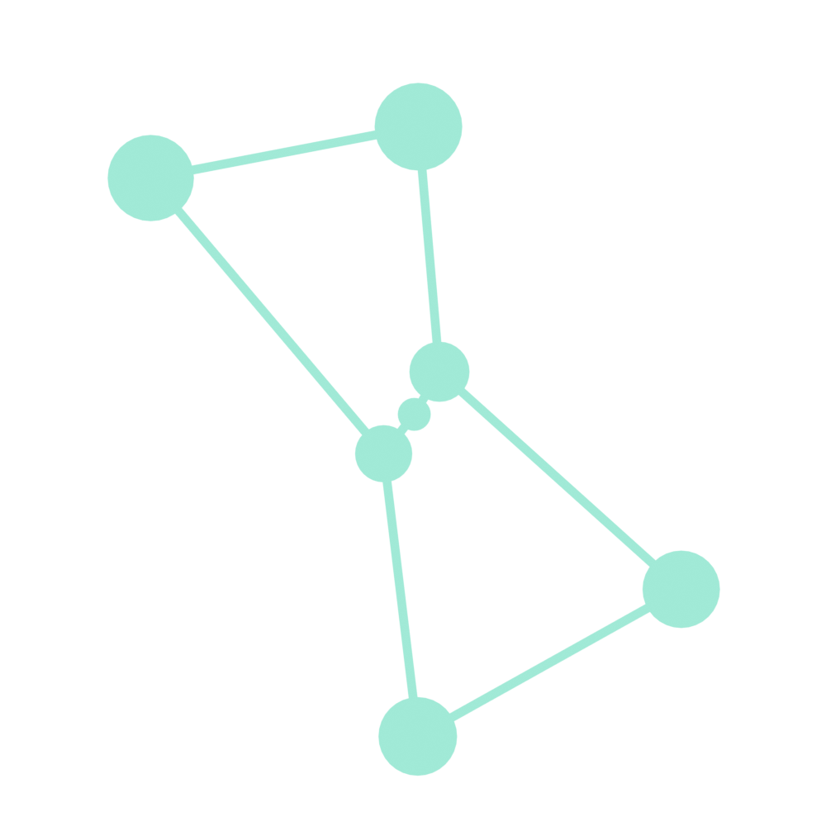


All 88 constellations in the entire sky as seen from Earth, even from the perspective of another planet.
Restore constellations that have disappeared in the past and display them on the site
Hold a contest for user-created constellations to stimulate space education.

